Slide 1

Babich Kirill
Berukhov Andrey
Klochkov Lev
Repina Anastasia

Slide 2
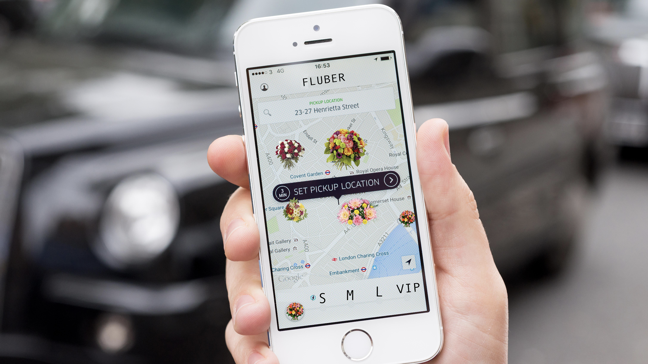
Idea

Slide 3
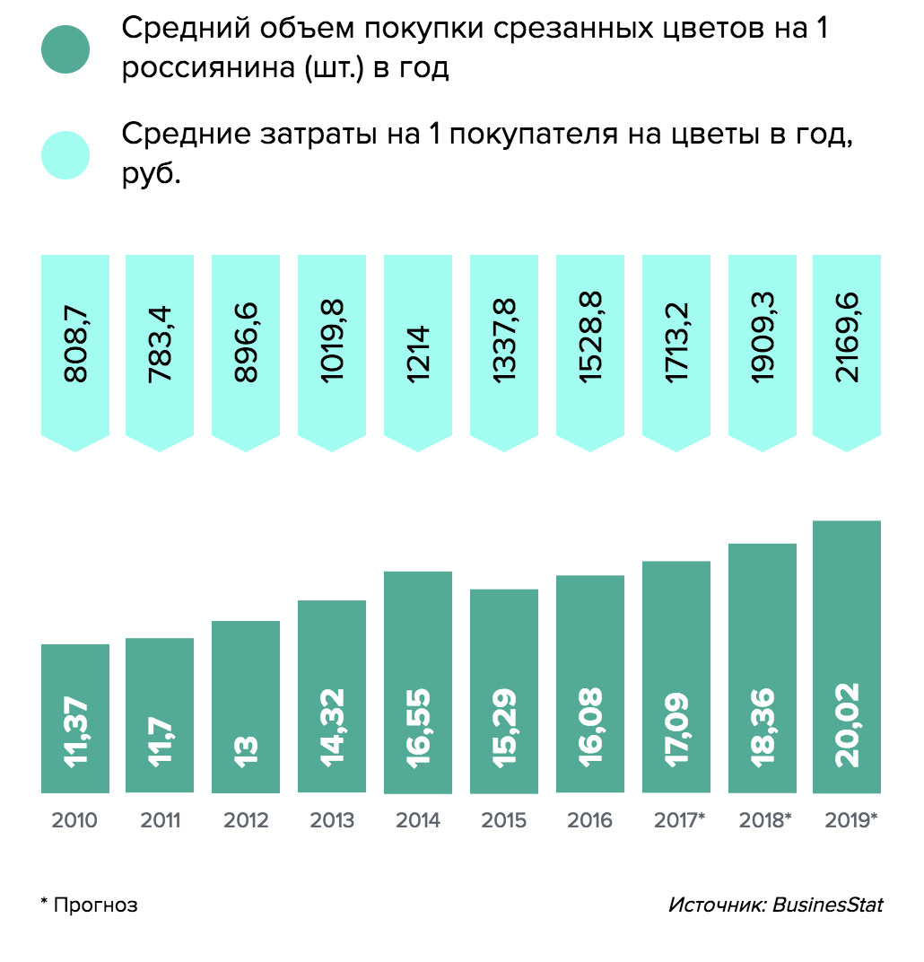
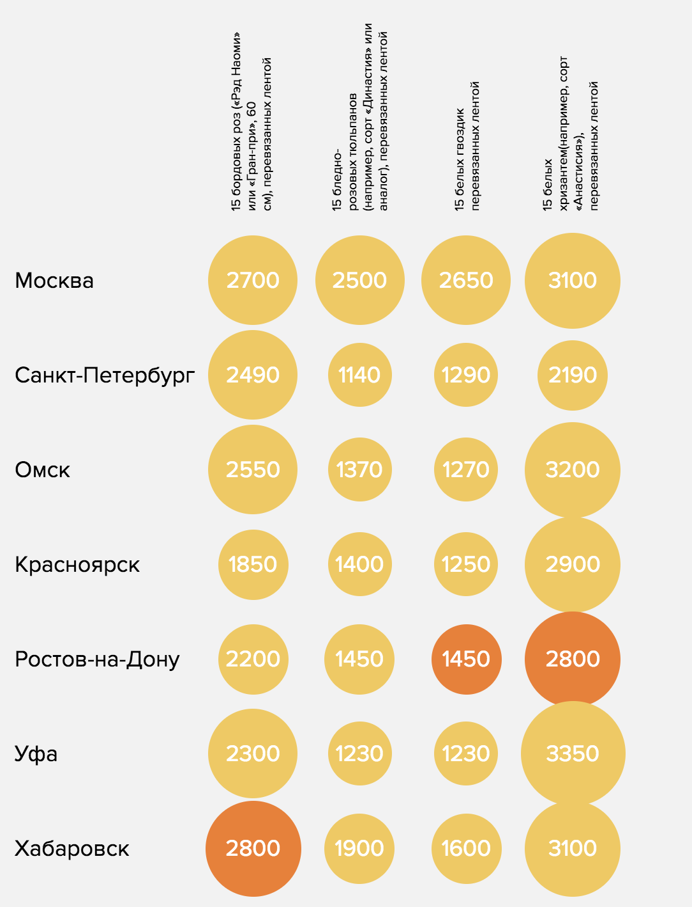
Flowers market in Russia
average flowers number per person in Russia per year
Bouquets price in 2017 in Russian cities, rubles
average expenses per person in Russia per year
15 roses
15 tulips
15 carnations
15 chrysanthemums
Moscow
Saint Petersburg
Omsk
Krasnoyarsk
Rostov
Ufa
Habarovsk
forecast
Source: BusinessStat
https://chestnok.ru/specproject/analitika-tsvetochnogo-rynka-rossii/

Slide 4
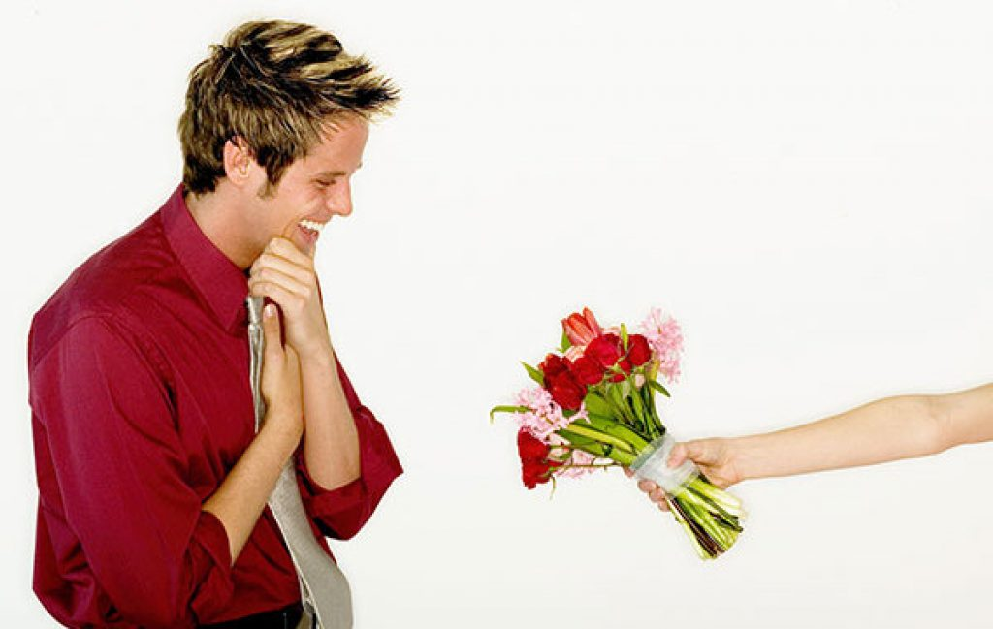
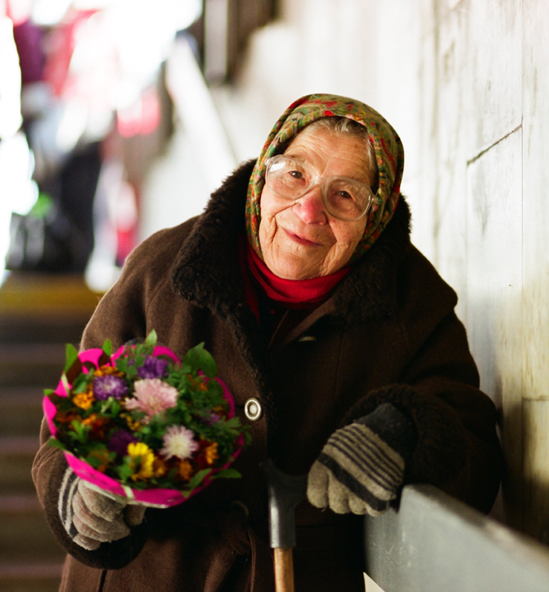
Main users
Buy & Sell Flowers

Slide 5
Functions
Flowers sale (for seller)
Flowers purchase (for buyer)
Filtration the results (to find the best variant)
Geotracking the sellers around and showing on map
Tracking the orders using notifications
Chat for buyer and seller

Slide 6
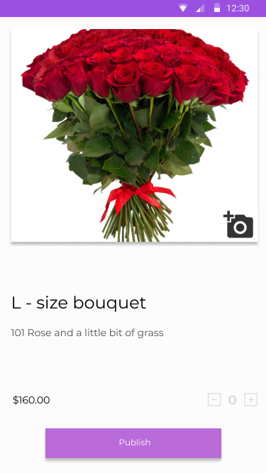
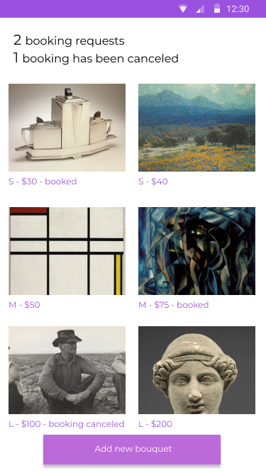

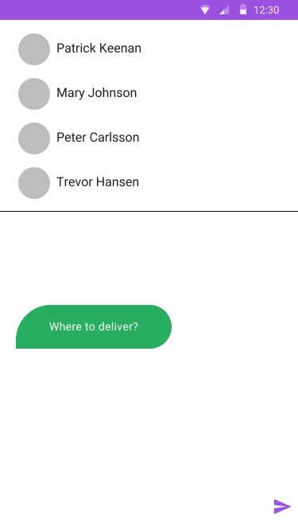
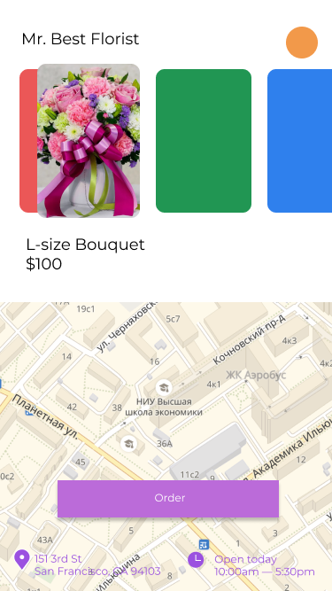
Mockups

Slide 7




Technologies

Slide 8
Thank you!
Contacts:
Babich Kirill - ksbabich@edu.hse.ru
Berukhov Andrey - asberukhov@edu.hse.ru
Klochkov Lev - lvklochkov@edu.hse.ru
Repina Anastasia - aarepina@edu.hse.ru

